Slide 1
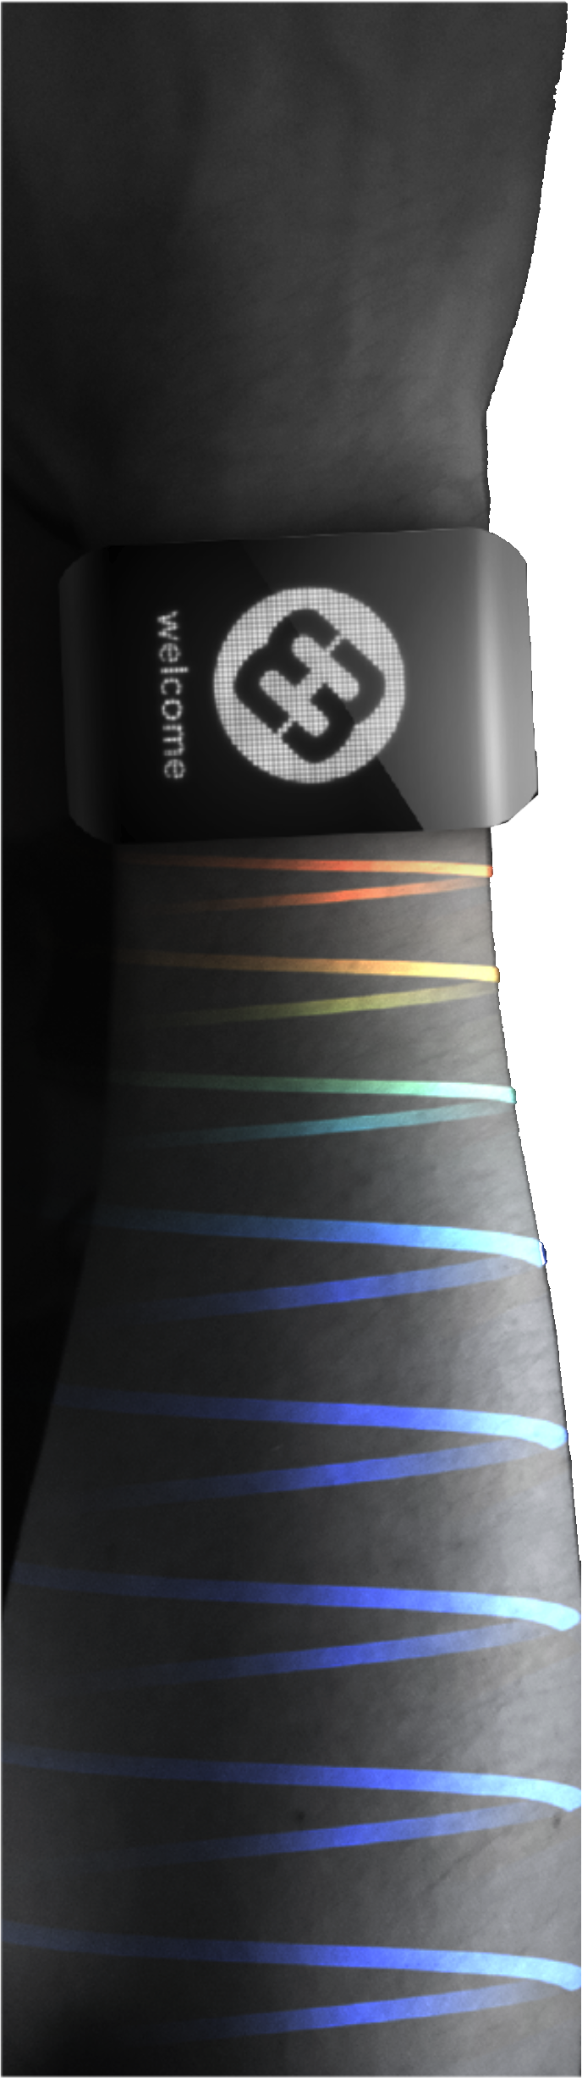


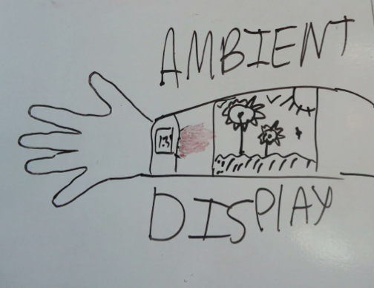
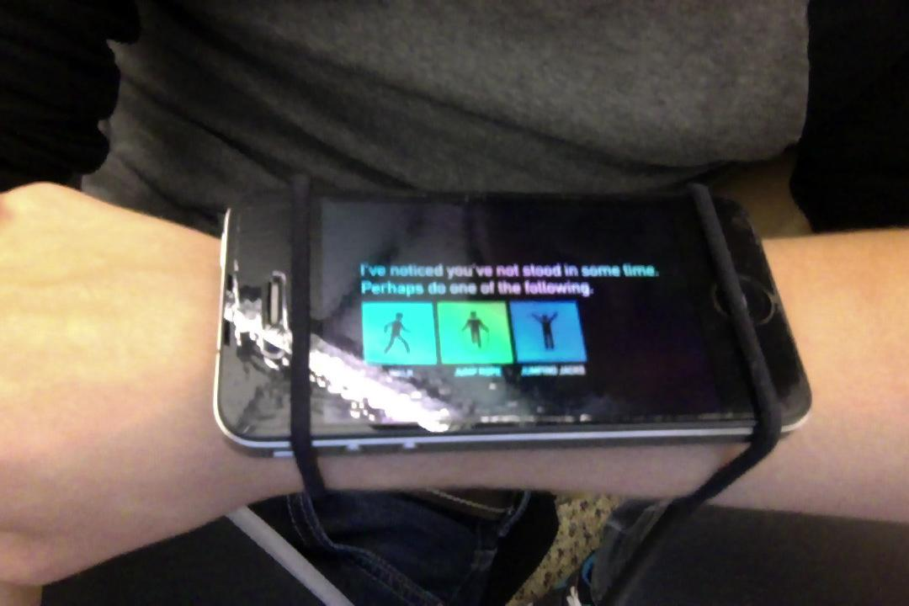
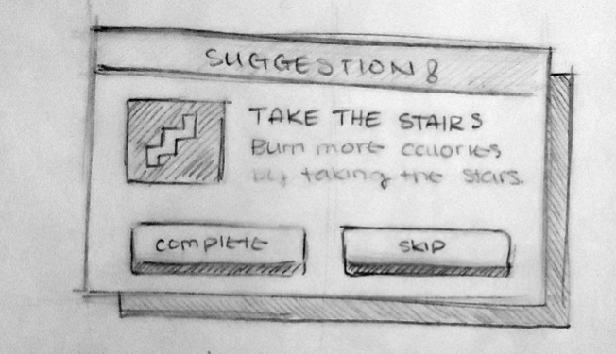

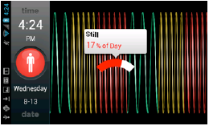
problem
Obesity is a worldwide epidemic affecting both children and adults, particularly in the United States, Europe, and China.
Lack of time is the leading factor in exercise deficiency.
solution
Encourage short bursts of exercise throughout the day to achieve a higher level of fitness and health
design iteration
Go for a short walk
Concept
Sketches
Low Fidelity
Prototype
High Fidelity Prototype
features
Ambient display for constant, visible feedback
Context aware actvity suggestions
Automatically adjusts activity level to user’s ability
*Felicia Cordeiro, *Randy Huynh, °Shen Li, Yu Xin
*University of Washington, Seattle
Beijing University of Posts & Telecommunications
°Tsinghua University
http://worldlab.cs.washington.edu/microhealth/

